Slide 1
Functional FTD
Taste of Haskell

Slide 2
Anderson A. Pavia
tecnólogo em Processamento de Dados
barachel em Direito
xadrez, tênis de mesa, ultimate frisbee
cubo mágico
andersonaap@hotmail.com
https://github.com/andersonaap
www.facebook.com/andersonpavia

Slide 3
f [] = []
f (x:xs) = f ys ++ [x] ++ f zs
where
ys = [a | a <- xs, a <= x]
zs = [b | b <- xs, b > x]

Slide 4
Começando
editor de texto
compilador/interpretador Haskell
GHC - https://www.haskell.org/platform/
Hugs
https://tryhaskell.org
https://www.haskell.org
https://www.fpcomplete.com/school
http://www.codewars.com/
https://www.hackerrank.com

Slide 5
Haskell
funcional pura - exceto IO ()
higher order
strongly typed
propósito geral

Slide 6
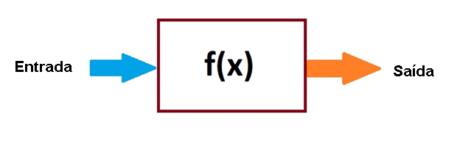
Função

Slide 7
Referências
http://novatec.com.br/livros/haskell/
http://www.amazon.com/Programming-Haskell-Graham-Hutton/dp/0521692695
http://learnyouahaskell.com
http://book.realworldhaskell.org
FP101x Introduction to Functional Programming - EDX
https://courses.edx.org/courses/course-v1:DelftX+FP101x+3T2015/info

Slide 8
Obrigado
Anderson Pavia

